Slide 1

INSY 695 TERM PROJECT
FEBRUARY 23RD 2024

Slide 2





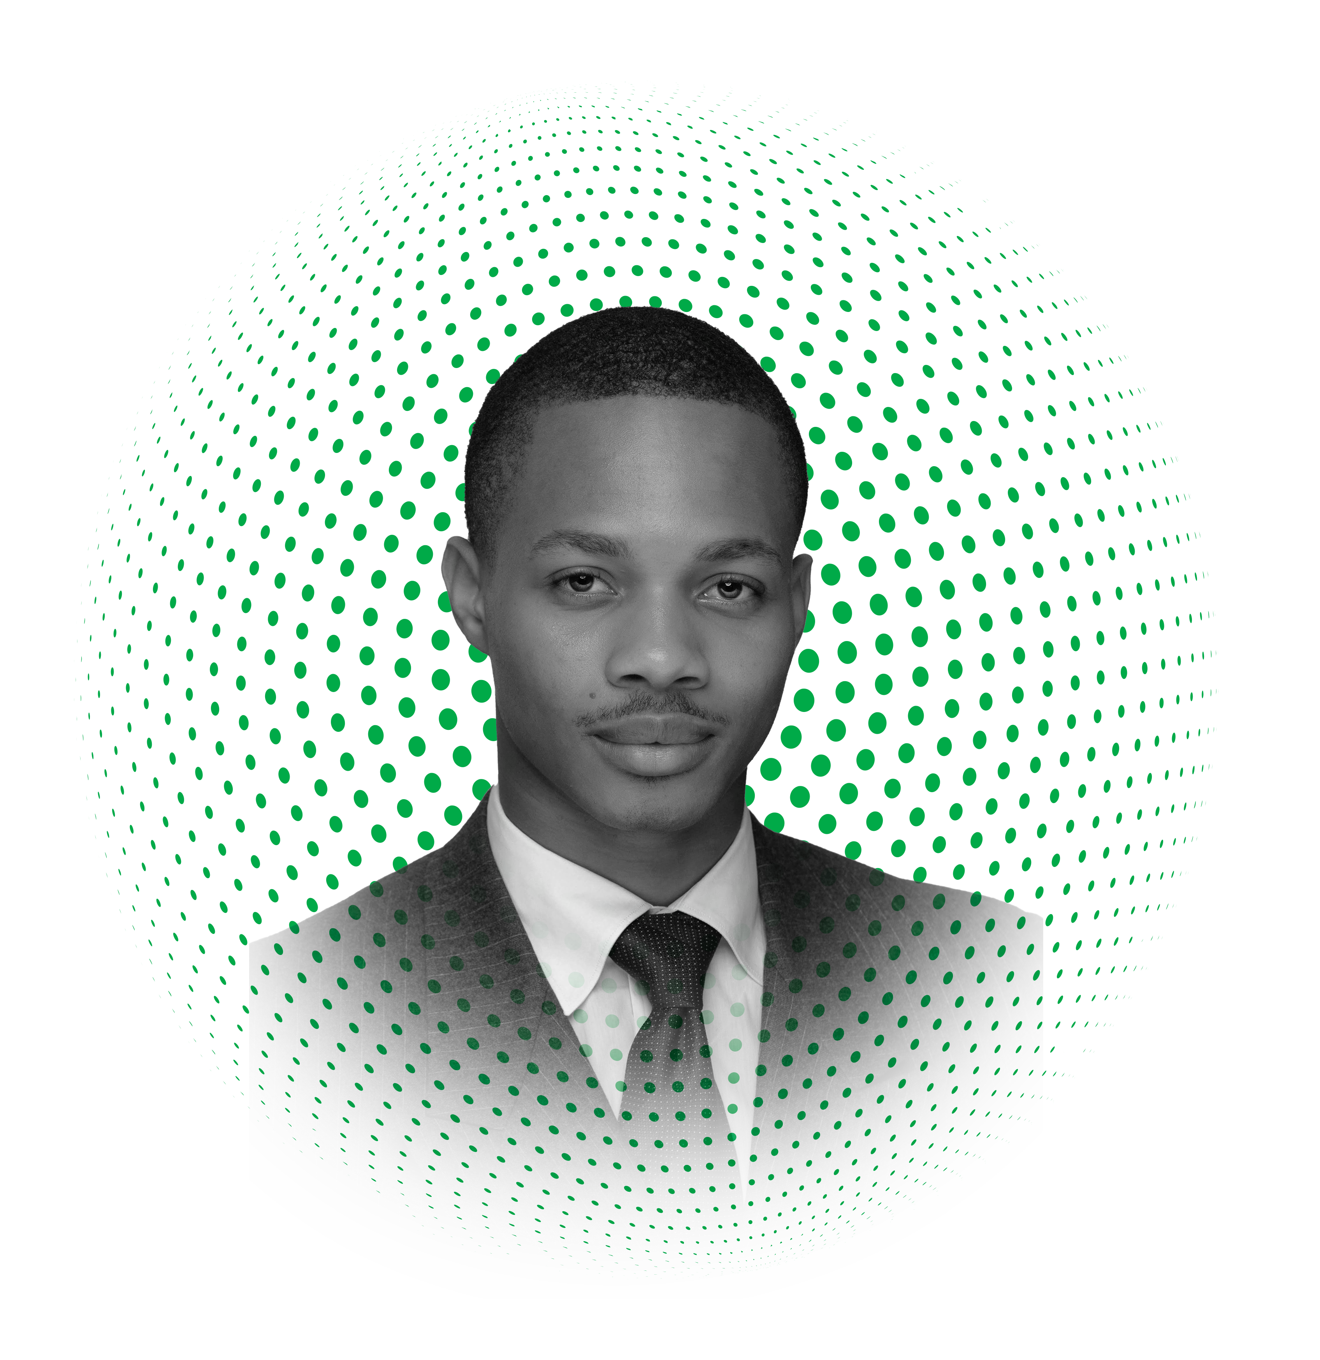
Meet the Revenue Radar Team
3 Data Scientists
2 Business Analysts
1 Data Analyst
ABDULRAHMAN AROWORAMIMO
DATA SCIENTIST
AMMAD SOHAIL
DATA SCIENTIST
ANGEL OLUWOLE-ROTIMI
BUSINESS ANALYST
RODRIGO CASTRO
DATA ANALYST
XINGHEN LUO DATA SCIENTIST
YVAN KAMMELU
BUSINESS ANALYST

